Slide 1
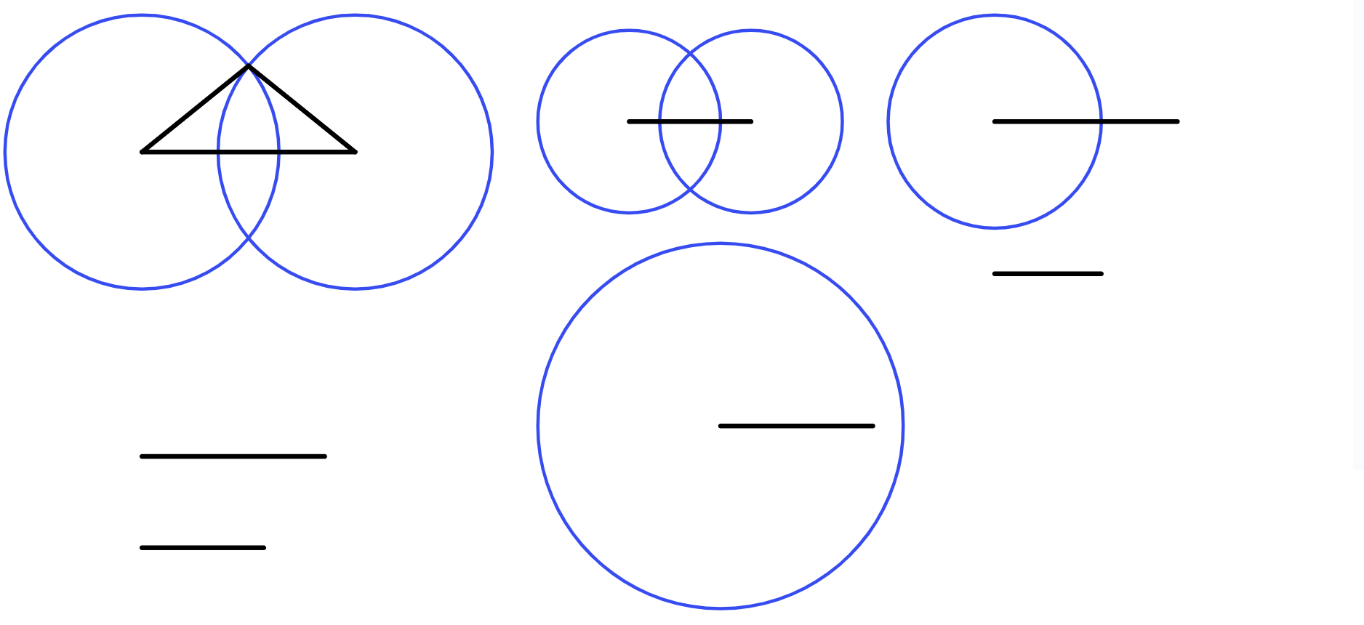
Perpendicular bisector of a line segment
Task A: Constructing rhombi to bisect a line segment
1) Give an explanation for why each construction doesn’t result in a perpendicular bisector of the line segment XY, and what can be done to make their construction better.
a)
b)
c)
X
Y
X
Y
X
Y
2) Find the perpendicular bisector for each line segment by constructing a rhombus.
A
B
C
D
E
F
G
H

Slide 2
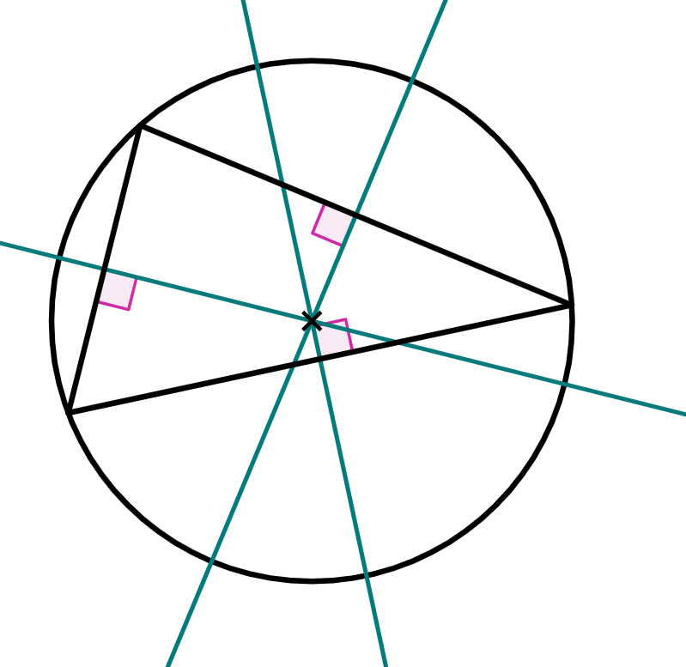
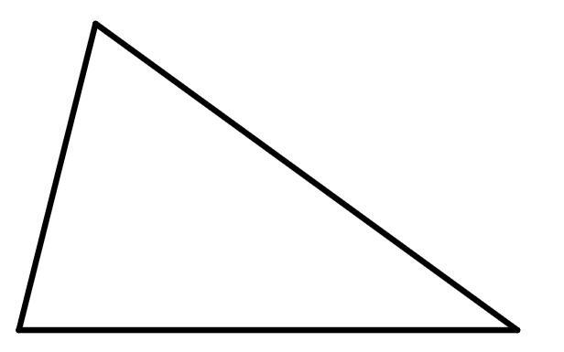
Perpendicular bisector of a line segment
Task B: Efficient construction of a perpendicular bisector
1) Complete the construction of each perpendicular bisector.
a)
b)
c)
d)
e)
2) The circumcentre of a triangle is a point that is the centre of a circle whose circumference intersects all three vertices of the triangle. The circumcentre can be found by finding the point where the perpendicular bisectors of each side of the triangle intersect.
Find the circumcentre of this triangle.
Mathematics in Education and Industry
v2.3

